Slide 1
Project Management
SE PROJ

Slide 2
Outline
What is Project Management?
Why is it important?
Basic Project Life Cycle
Gantt Chart

Slide 3
What is PM?
The initiation, planning, execution, control and termination of projects in a formal, directed and intelligent fashion
Others may perceive it as boring, extra work, useless, distraction from real work etc
It’s all about balancing the “science” of Project Management (what you “should” do) with the “art” of PM (what you actually NEED to do)

Slide 4
Why PM?
Because companies are organized around projects (and processes)
Because project management is recognized as a core competence
Because project management is a discipline in disarray—we just don’t know how to manage projects well
Because project management differs in significant ways from ordinary management

Slide 5
Life Cycle of PM
Initiating
Planning
Closing
Controlling
Executing

Slide 6
Associated Outputs from stages
Initiating – Project Feasibility, Project Initiation/Kick-off Document
Planning – Gantt Charts, WBS( work breakdown structure), Schedules, Task Lists, Resource Levelling Charts
Executing/Controlling – Task Lists, Issue Lists, Bug Lists, Deliverables
Closing – Close-out Documents, Customer Satisfaction Assessments, Payment (!)

Slide 7
Planning
Looks at- cost, duration, functionality
You may also need to plan for: time management & communication, team meetings
Duration or project schedule is done using Gantt chart

Slide 8
Planning cont..
List the tasks to be done
Group into phases (e.g. researching, modeling, implementation, testing, writing up etc)
Guesstimate effort required for each task & hence each phase, adjust the scope of your project accordingly if necessary (e.g. if there is not sufficient time to do it all, reduce the scope of the project accordingly)
Consider risk, especially in unknown areas & possible consequences & contingencies

Slide 9
Check your estimates
Get your supervisor’s input to your guesstimates
Be realistic about how much you can reasonably achieve in the time available– you want to end up with a fully finished project by the deadline (including testing and writing-up) not a half-finished, overly ambitious one!
Plan to commence writing-up as soon as practical – don’t put it off until the end! Editor must control this

Slide 10
Planning –Tracking Progress
The solution is not to plan tasks and not to measure progress in % complete.
Instead, only plan milestones – just plan them small enough that it gives you visibility of progress
Binary completion (is it done? Y or N) is MUCH more successful as a measure of progress (60/100 milestones reached)
Identify clear milestones in the project, these provide focus and a clear measure of progress, thereby helping you to control your project. For example completion of literature search, completion of design, completion of construction, completion of testing, etc.
Avoid fudging milestones (e.g. design 95% complete)

Slide 11
Finish the project plan
Finish writing down your project plan; it can be based on a Gantt chart (or a PERT chart)
Double check it is feasible & reasonable in terms of timescale and all resources, including labor, materials etc
Give it an issue number (No.1) & stick it up on the wall where you can see it every day!
It is your road map, your route to your goal, don’t forget it, don’t ignore it, or your project will come back and bite you!
Keep to it & it will earn you marks!

Slide 12
Execution
Don’t jump straight into detailed technical work
Sort out the top level design first & write it down! Also, try to keep the design modular – it will help later with project control, testing & fault finding. Do models using VP
Write little specifications for each module and how they will interface with each other, if possible
Try to make the design robust, so if one part doesn’t work as intended its impact on the rest is minimized & alternatives can be considered
Before starting detailed design work - discuss your outline design with your supervisor!

Slide 13
Controlling
Having broken your project down into manageable chunks & having milestones gives you simple, short-term targets to keep in mind & work towards on a day-to-day basis
Look at your project plan every few days & consider your progress
Have regular project reviews at agreed intervals with you supervisor at which you discuss progress & look forward. Discuss any risks to your project

Slide 14
Gantt Chart
A GANTT chart is a type of bar chart that illustrates a project schedule.
GANTT charts have become a common technique for representing the phases and activities of a project work breakdown structure.
It was introduced by Henry Gantt around 1910 – 1915.
Symbols include:
A black diamond: milestones or significant events on a project with zero duration
Thick black bars: summary tasks
Lighter horizontal bars: tasks
Arrows: dependencies between tasks

Slide 15
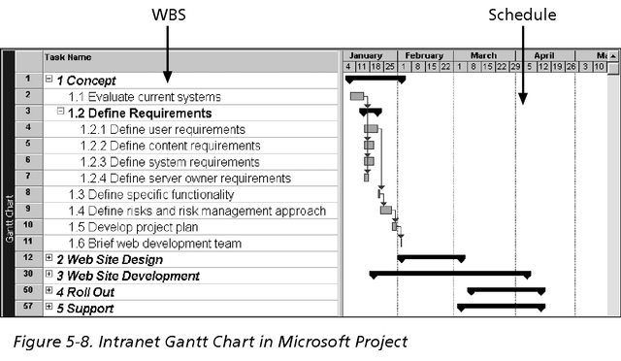
Gantt Chart example

Slide 16
